Slide 1
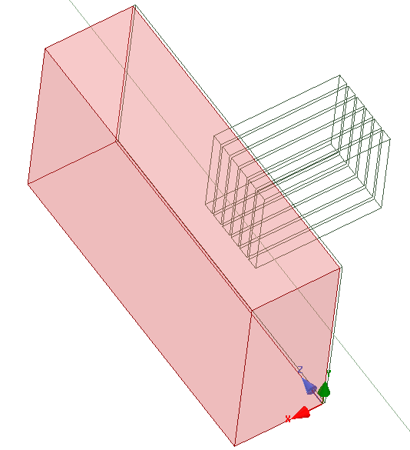
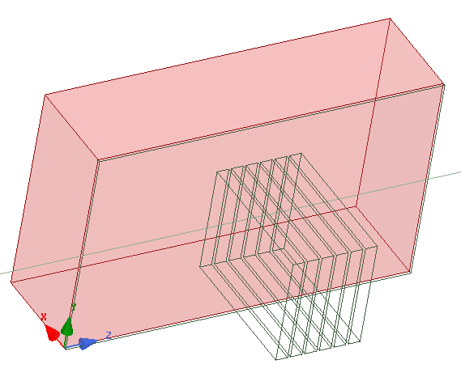
Geometry:
6 waveguides 76x8.5mm
3.7 GHz
d_gap vacuum (2 mm, tunable)
Plasma:
Ne₀=N x Ne_{c}
1 gradient de lambda

Slide 2
Boundary Conditions
No boundary conditions (ie. PEC all around).
This will work only if attenuation in the plasma medium is sufficient (no fields at boundaries)

Slide 3
Permittivity :
1, 1, 1-$N_nc*(1+(X-$dgap)*1e-3/$L_n)
Losses in conductivity:
if(X>10e-3, $loss_factor*(X - 10e-3)^2, 0) + if(Z>180e-3, $loss_factor*(Z - 180e-3)^2, 0) + if(Z<40e-3, $loss_factor*(-Z +40e-3)^2, 0)

Slide 4
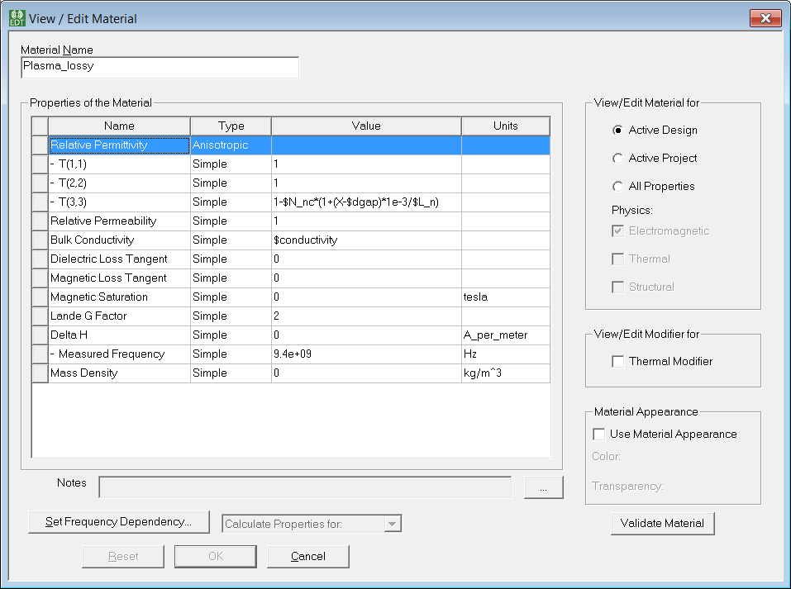

Slide 5
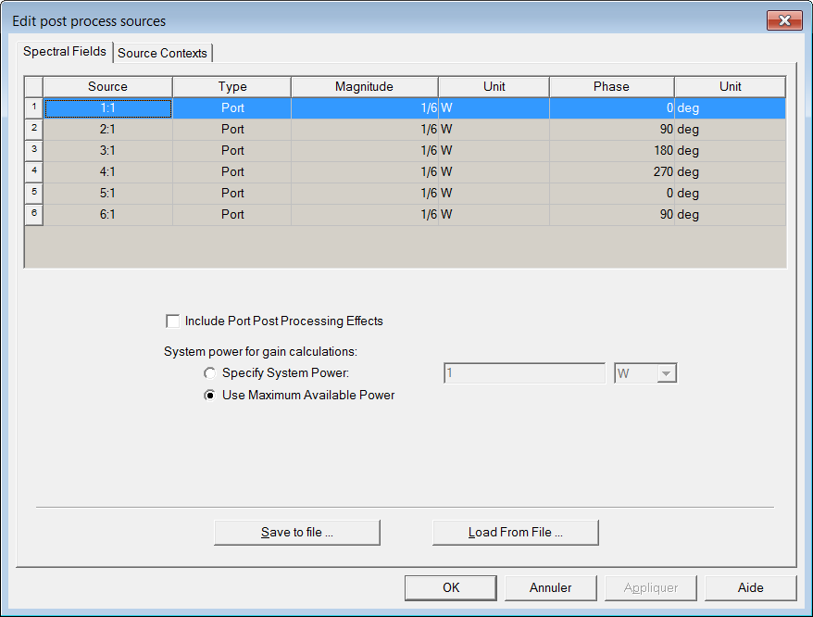
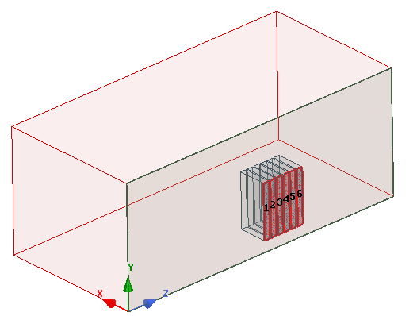
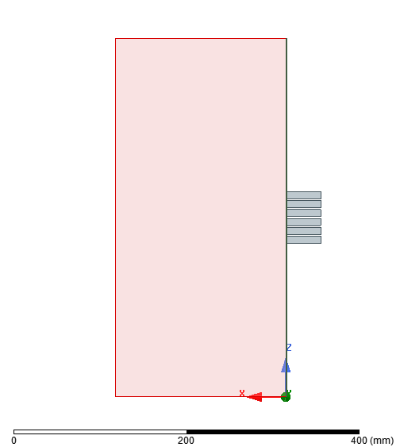
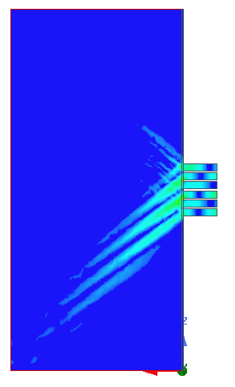

Slide 6
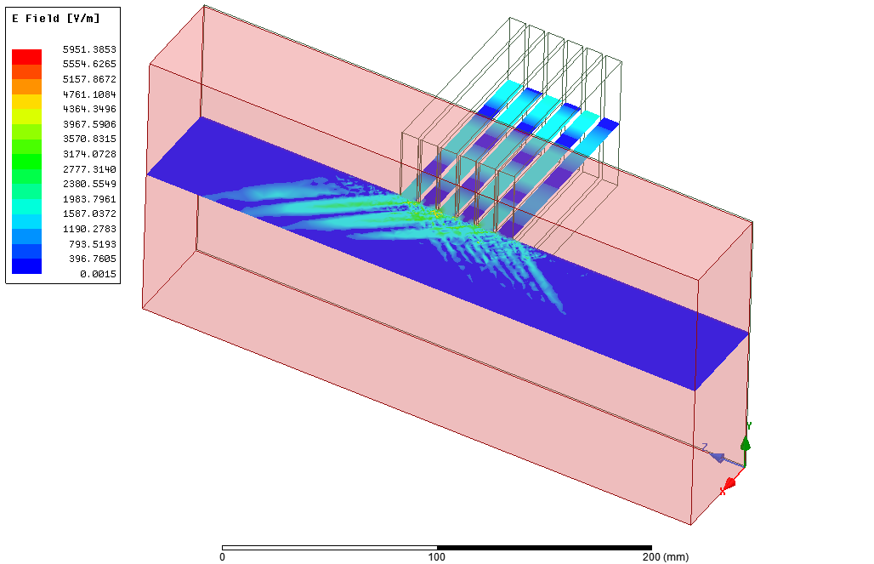

Slide 7
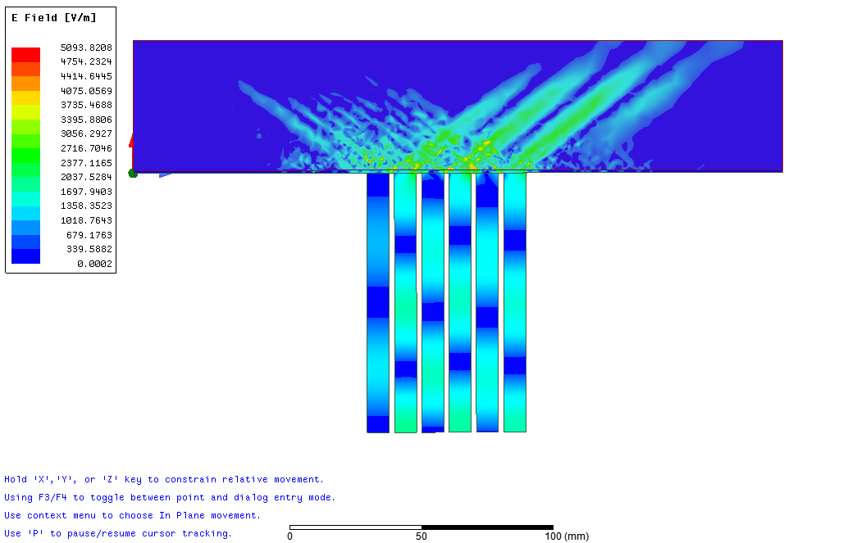
Lin scale 3nc, Ln 1cm, 1mm gap
128 000

Slide 8
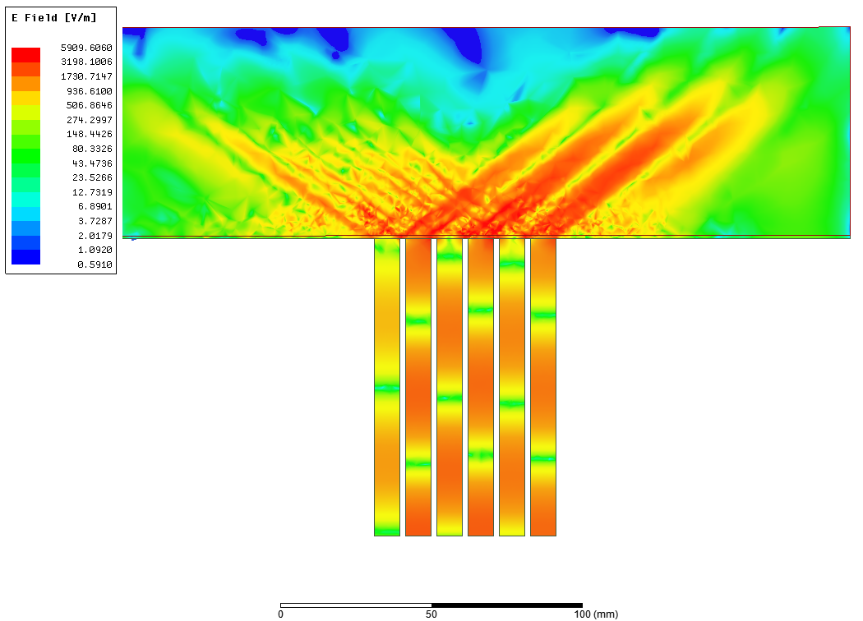
Log scale 3nc, Ln 1cm, 1mm gap
128 000

Slide 9
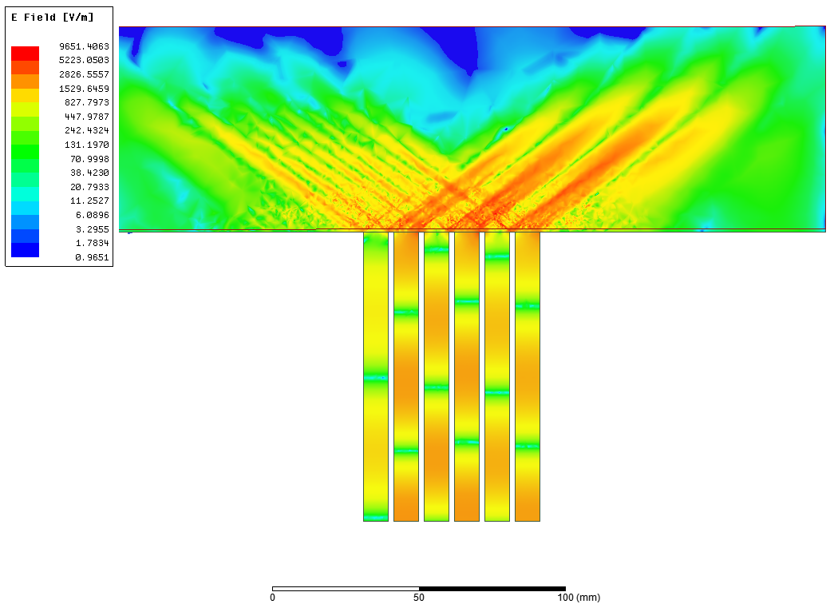
Log scale 3nc, Ln 1cm, 1mm gap
340 000

Slide 10
Log scale 3nc, Ln 1cm, 1mm gap
340 000

Slide 11
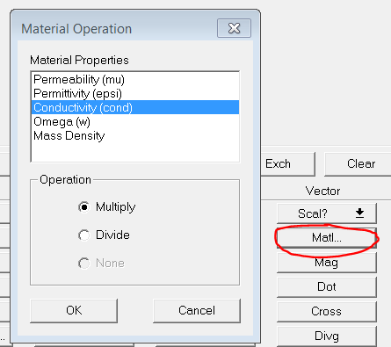
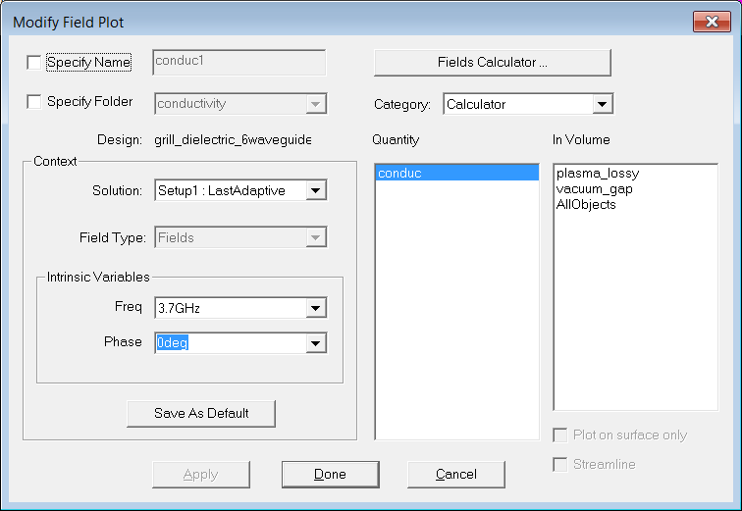

Plotting the conductivity
The conductivity in HFSS (cond) can be found in the calculator as a tensor :
But in order to plot the conductivity as field overlay, it must be defined as a scalar (Scl). So I’ve projected it on x first (Number->Vector->1,0,0, then Matl->Conductivity, then Mag

Slide 12
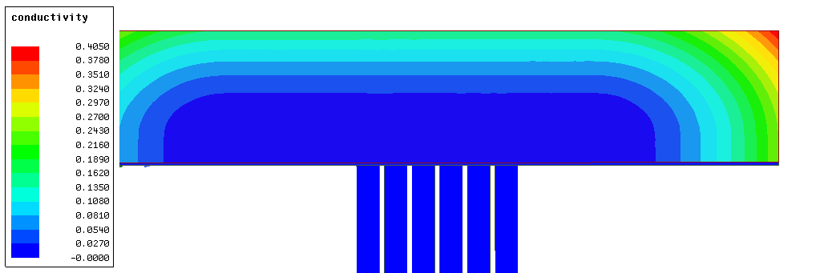
conductivity
No loss region

Slide 13
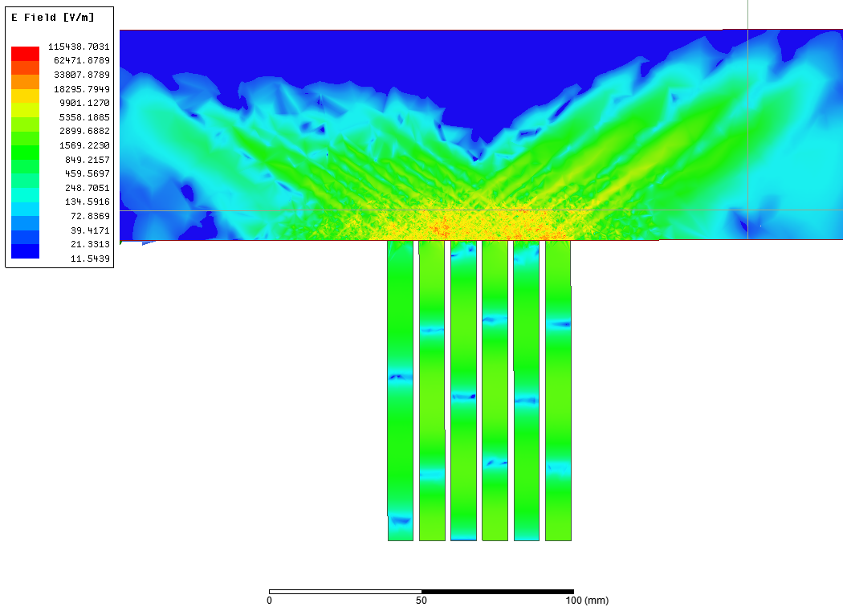
Plasma directly, high convergence

Slide 14
